Slide 1
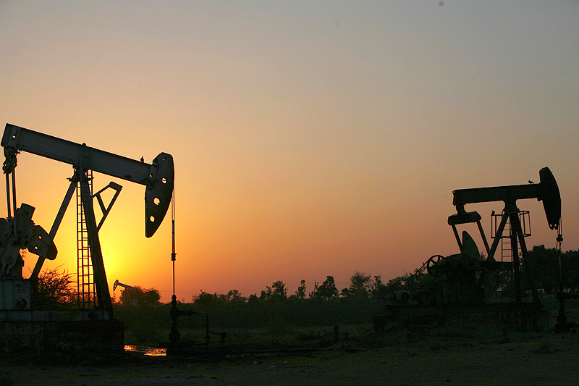

‘Web-based Visualisation and full Interactivity of Oil and Gas Industry LAS Data’
TEAM:
Archit Garg
Muskan Tyagi
Dhruv Goyal
Shreya Verma
Rohan Rana

Slide 2
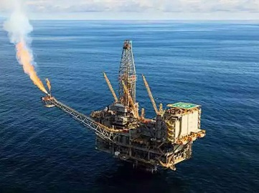
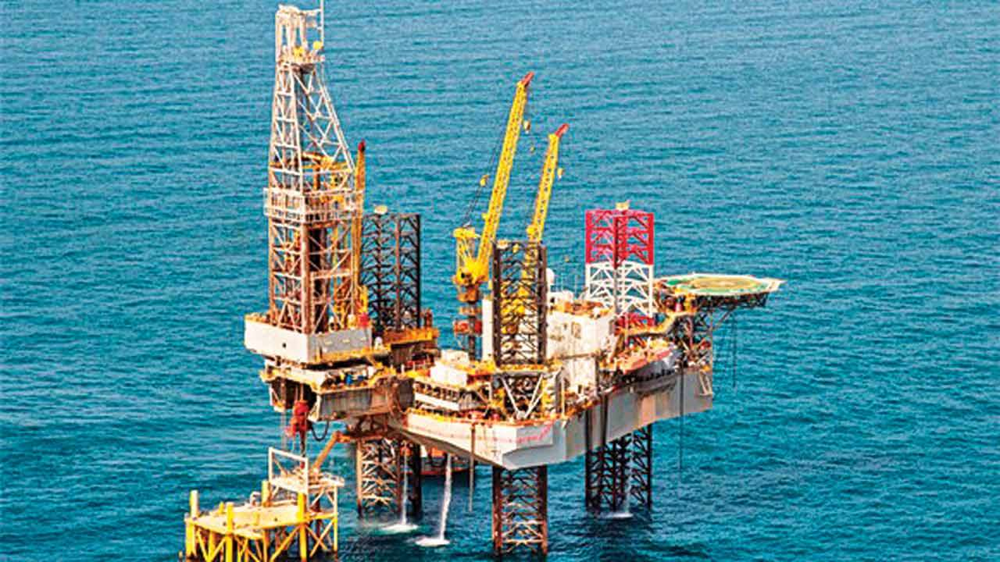
INTRODUCTION
Oil and Natural Gas Corporation is an Indian government-owned crude oil and natural gas corporation. Its registered office is in New Delhi. It is under the ownership of Ministry of Petroleum and Natural Gas, Government of India.
During this Summer Training 2021 at ONGC, the project which we worked upon was ‘Web-based Visualisation and full Interactivity of Oil and Gas Industry LAS Data’.

Slide 3
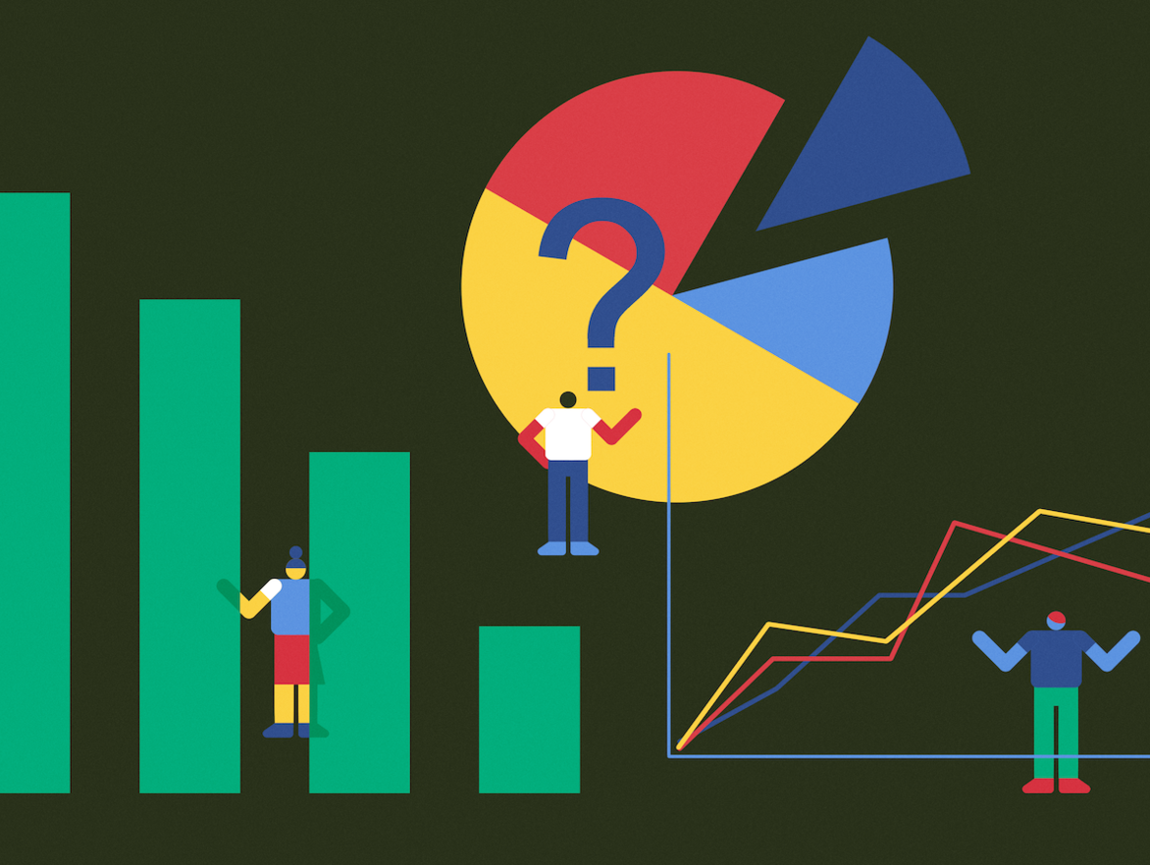
WHAT IS
DATA VISUALISATION
?

Slide 4

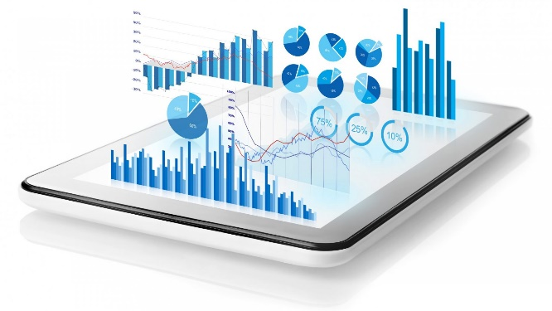
WHAT IS DATA VISUALISATION ?
Data visualization is the graphical representation of information and data. By using visual elements like charts, graphs, and maps, data visualization tools provide an accessible way to see and understand trends, outliers, and patterns in data.
In the world of Big Data, data visualization tools and technologies are essential to analyse massive amounts of information and make data-driven decisions.

Slide 5

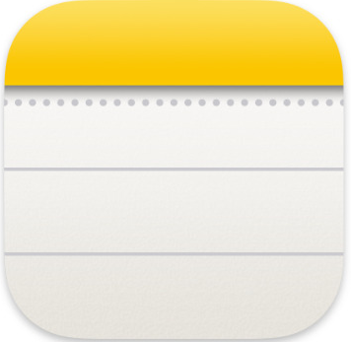
Read LAS 2.0 Data using Python and serve using JSON format in Flask.
Create Linear, Log & Depth Track using ‘Highcharts’ front end JavaScript library.
Assembling tracks in Well template and Visualization.
Creating a Home screen and assembling.
Modification of properties of curves.

Slide 6
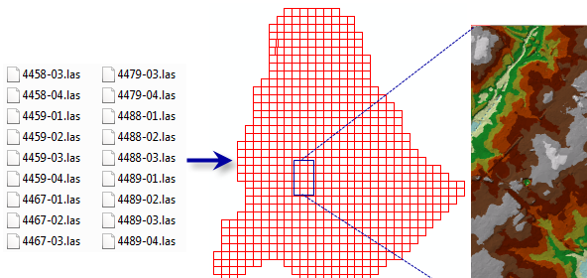
WHAT IS LAS DATA ?
A LAS dataset stores reference to one or more LAS files on disk, as well as to additional surface features. A LAS file is an industry-standard binary format for storing airborne lidar data. The LAS dataset allows you to examine LAS files, in their native format, quickly and easily, providing detailed statistics and area coverage of the lidar data contained in the LAS files.
A LAS dataset can also store reference to feature classes containing surface constraints. Surface constraints are breaklines, water polygons, area boundaries, or any other type of surface feature that is to be enforced in the LAS dataset.
Log ASCII Standard, LAS, is a format specification for storing and distributing digital well log data. The standard was defined and is maintained by the Canadian Well Logging Society. LAS 2.0 is the most used digital well log distribution format. (note, remove the below bullets)

Slide 7

TECHNOLOGIES USED

Slide 8

FLASK FRAMEWORK
Flask is a micro web framework written in Python. It is classified as a micro framework because it does not require particular tools or libraries. It has no database abstraction layer, form validation, or any other components where pre-existing third-party libraries provide common functions. However, Flask supports extensions that can add application features as if they were implemented in Flask itself.

Slide 9
SOME ELEMENTS OF FLASK
HTTP Methods
Request
To process incoming data in Flask, you need to use the request object, including mime-type, IP address, and data. HEAD: Un-encrypted data sent to server w/o response.
GET
Sends data to the server requesting a response body.
POST
Read form inputs and register a user, send HTML data to the server are methods handled by the route. Flask attaches methods to each route so that different view functions can handle different request methods to the same URL.
Response
Flask invokes a view function. It has to return a response value to the client. HTTP requires it to be more than a string response, a status code.

Slide 10

IMPORTING PYTHON LIBRARIES
Imported Python libraries such as:
LAS Convertor
flask libraries such as jsonify
render_template
make_response
Created an object of flask and define flask route as upload.

Slide 11
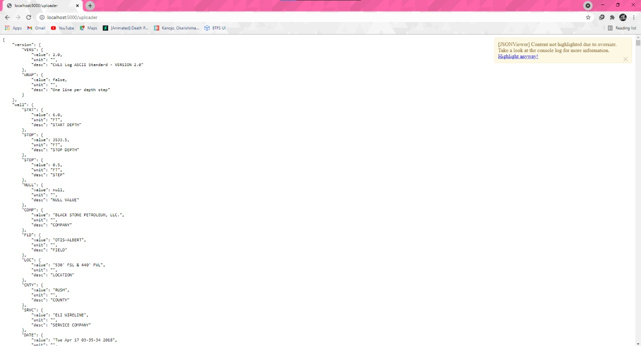
LAS FILE UPLOADED IN JSON FORMAT

Slide 12

JAVASCRIPT ‘HIGHCHARTS’ LIBRARY
JavaScript: JavaScript is a scripting or programming language that allows you to implement complex features on web pages — every time a web page does more than just sit there and display static information for you to look at — displaying timely content updates, interactive maps, animated 2D/3D graphics, scrolling video jukeboxes, etc. — you can bet that JavaScript is probably involved. It is the third layer of the layer cake of standard web technologies, two of which (HTML and CSS) we have covered in much more detail in other parts of the Learning Area.

Slide 13

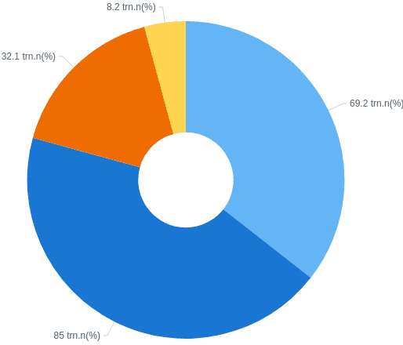
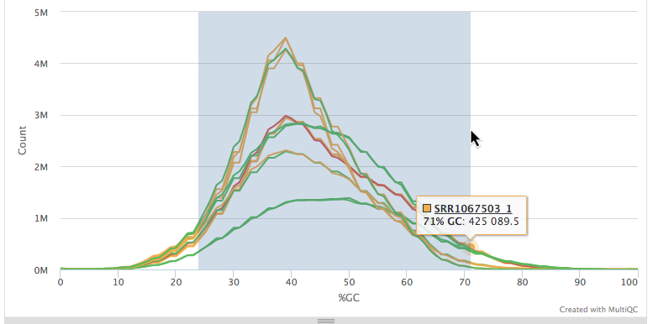
‘HIGHCHARTS’ LIBRARY
Highcharts:Highcharts is a library written purely in JavaScript used to enhance web applications by inserting charts capable of interaction. ... You can choose highchart pie charts, highchart line charts, spline charts, area charts, highchart bar charts, etc., to represent your data.

Slide 14
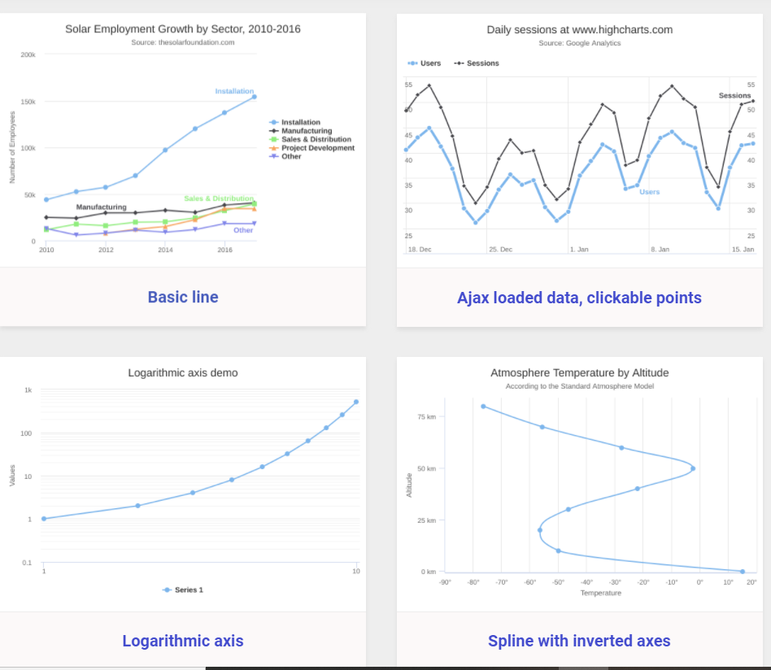
SOME COMMON TYPE OF HIGH CHARTS

Slide 15

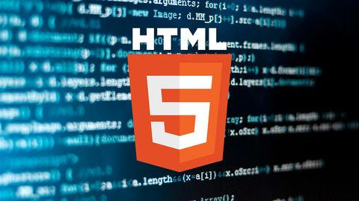
HTML
HTML (HyperText Markup Language) is the most basic building block of the Web. It defines the meaning and structure of web content. Other technologies besides HTML are generally used to describe a web page's appearance/presentation (CSS) or functionality/behaviour (JavaScript).
"Hypertext" refers to links that connect web pages to one another, either within a single website or between websites. Links are a fundamental aspect of the Web. By uploading content to the Internet and linking it to pages created by other people, you become an active participant in the World Wide Web.

Slide 16

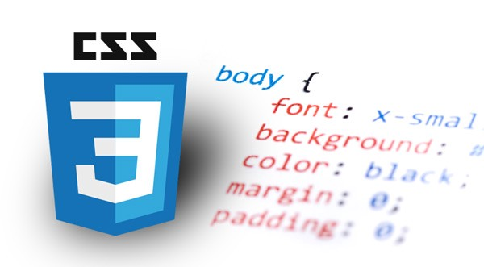
CSS
Cascading Style Sheets, fondly referred to as CSS, is a simple design language intended to simplify the process of making web pages presentable. CSS is used to control the style of a web document in a simple and easy way.
Cascading Style Sheets is a style sheet language used for describing the presentation of a document written in a markup language such as HTML. CSS is a cornerstone technology of the World Wide Web, alongside HTML and JavaScript.

Slide 17
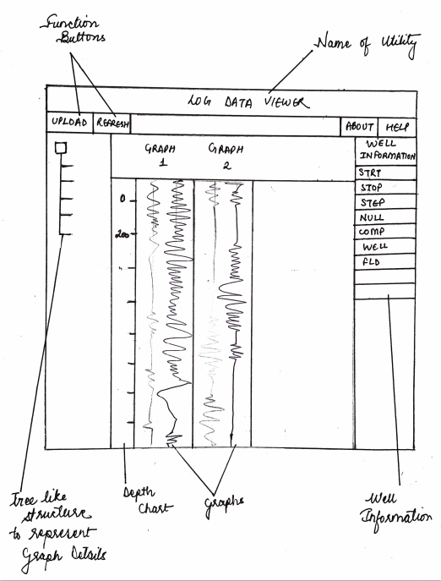
PEN-PAPER DRAFT DESIGN OF HOMEPAGE

Slide 18
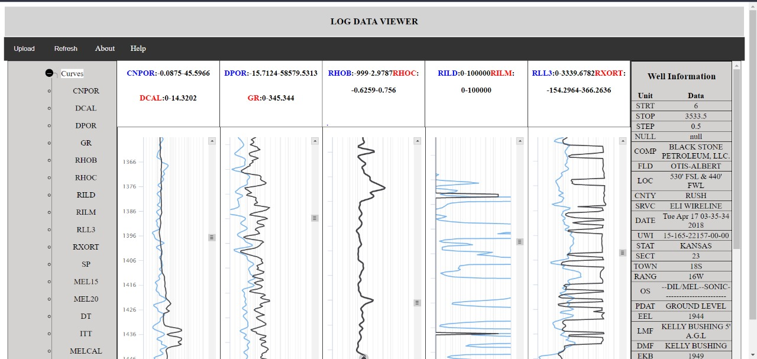
HOME PAGE

Slide 19

LEARNING OUTCOMES
The learning outcomes of this Training/Project can be listed as:
Developed and worked over this project in a limited time span of 1 month.
/Learnt new skills and technologies.\
Got hands on experience on the working of new technologies and frameworks such as Flask, LAS Data, Highcharts JavaScript, etc.
Learnt how to work individually and as a team since this whole training was on virtual platform.

Slide 20
CONCULSION
We were successfully able to visualise LAS 2.0 Data over this web-based utility that we created.
The files are successfully being uploaded and visualised on the Home Page.

